Slide 1
Bayes’ Theorem
A presentation By Ahron Barnett

Slide 2
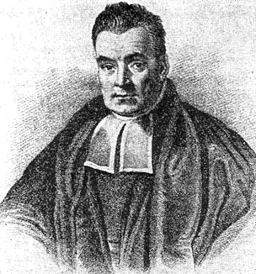
Thomas Bayes
English statistician, philosopher and minister
Born in 1701 in London
Never published his most famous work, "Baye's Theorem"
His notes were publish after his death in 1761 by his friend Richard Price

Slide 3

What is bAye's theorem?
Way of calculating the probability a hypothesis is true, given knowledge of conditions related to the event
Example: You take a test for cancer and it comes back positive, what is the likelihood you actually have cancer?

Slide 4
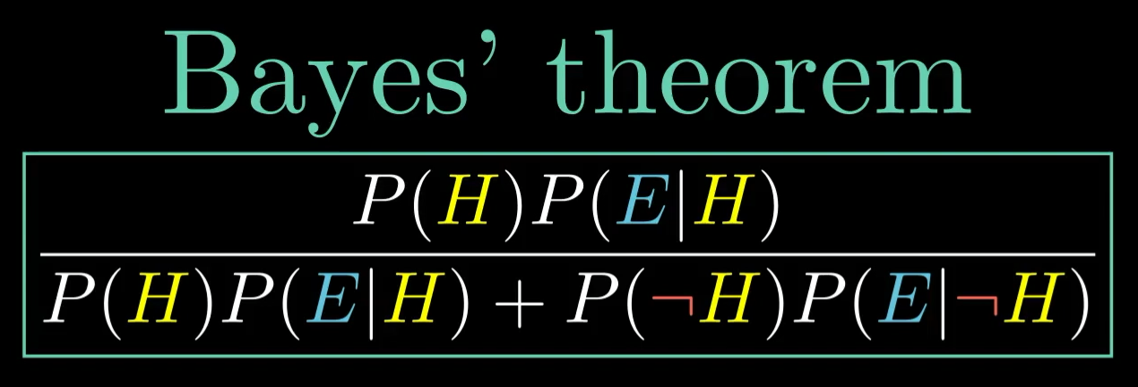
How does it work?
Let P(H) = the probability the hypothesis is true (or how probable you believe it to be before given the additional data)
Let P(E|H) = the probability of the event, given the hypothesis is true
Divided by the probability of the hypothesis being true and the event happening plus the hypothesis being false and the event happening

Slide 5

In practice: Defect detection
If it IS defective, it is spotted 98% of the time
If it is NOT defective, it will NOT signal that it is defective 99% of the time
0.1% of items are defective
P(says defective| is defective) = (0.98)
P(says defective | not defective) = 1 – 0.99 = (0.01)
P(defective) = (0.001)
P(not defective) = 1 – 0.001 = (0.99)
What is the probability a product is defective if the machine says its defective?
P(is defective | says defective)
=
P(says defective| is defective)*P(defective)
P(says defective| is defective)*P(defective)+P(says defective | not defective)*P(not defective)
=
(0.98)(0.001)
(0.98)(0.001)+(0.01)(0.99)
=
0.09 or 9%

Slide 6

What does this imply?
When the machine says a product is defective, there is an 9% chance of it actually being defective
Does this mean the machine is near useless?
The machine is conditionally very accurate
Unconditionally, not so much

Slide 7
What if we try again?
Scan the product that was claimed to be defective again
It again says positive, what is the likelihood now that it is actually defective?
Plug the calculated value from the last scan back into the formula
(0.98)(0.09)
(0.98)(0.09)+(0.01)(0.99)
=
0.899 or nearly 90%
We are now 90% confident that the product is defective.

Slide 8
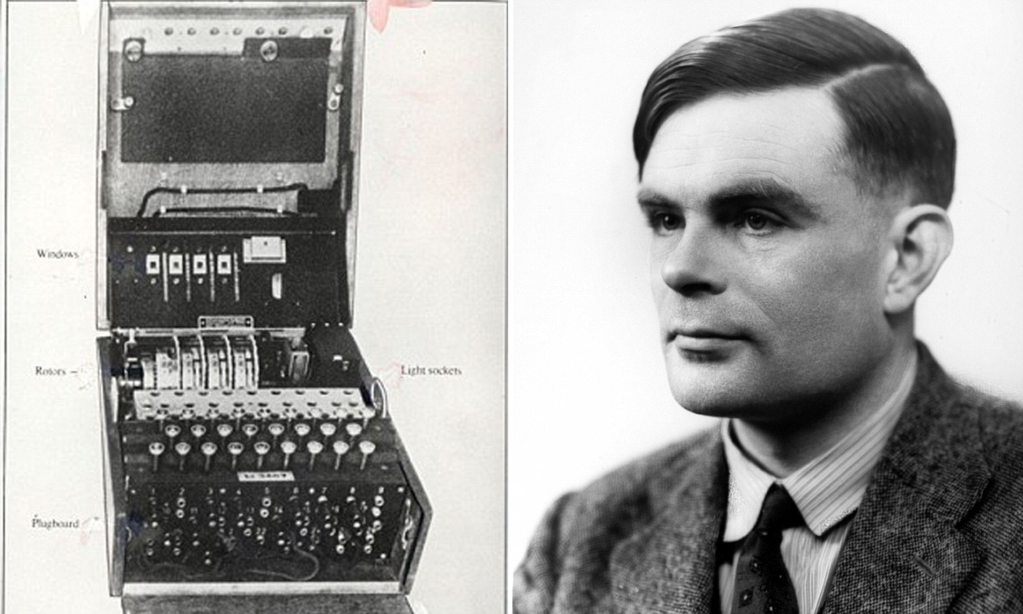

Closing thoughts
A useful tool for updating our beliefs
Used by Alan Turing to crack the enigma code
Used to find a lost nuclear bomb
Used today in genetic research

Slide 9
